Slide 1
GeoKings
Design Review III
Team Members
Andrew Usvat
Zack Bryant
John Cardeccia
Jackson Brittain
Alex Poole
Client
United States Geological Survey (USGS)
Astrogeology Science Center

Slide 2

Big Picture
The universe extends over a radius of about 15 billion light years.
We want to increase space exploration.
Images and maps help increase exploration.
https://www.google.com/url?sa=i&url=https%3A%2F%2Fwww.freeiconspng.com%2Fimages%2Fearth-png&psig=AOvVaw1

Slide 3




Clients
usgs.gov
Amy Stamile Dr. Jay Laura Trent Hare
Software Developer Software Lead Cartographer

Slide 4
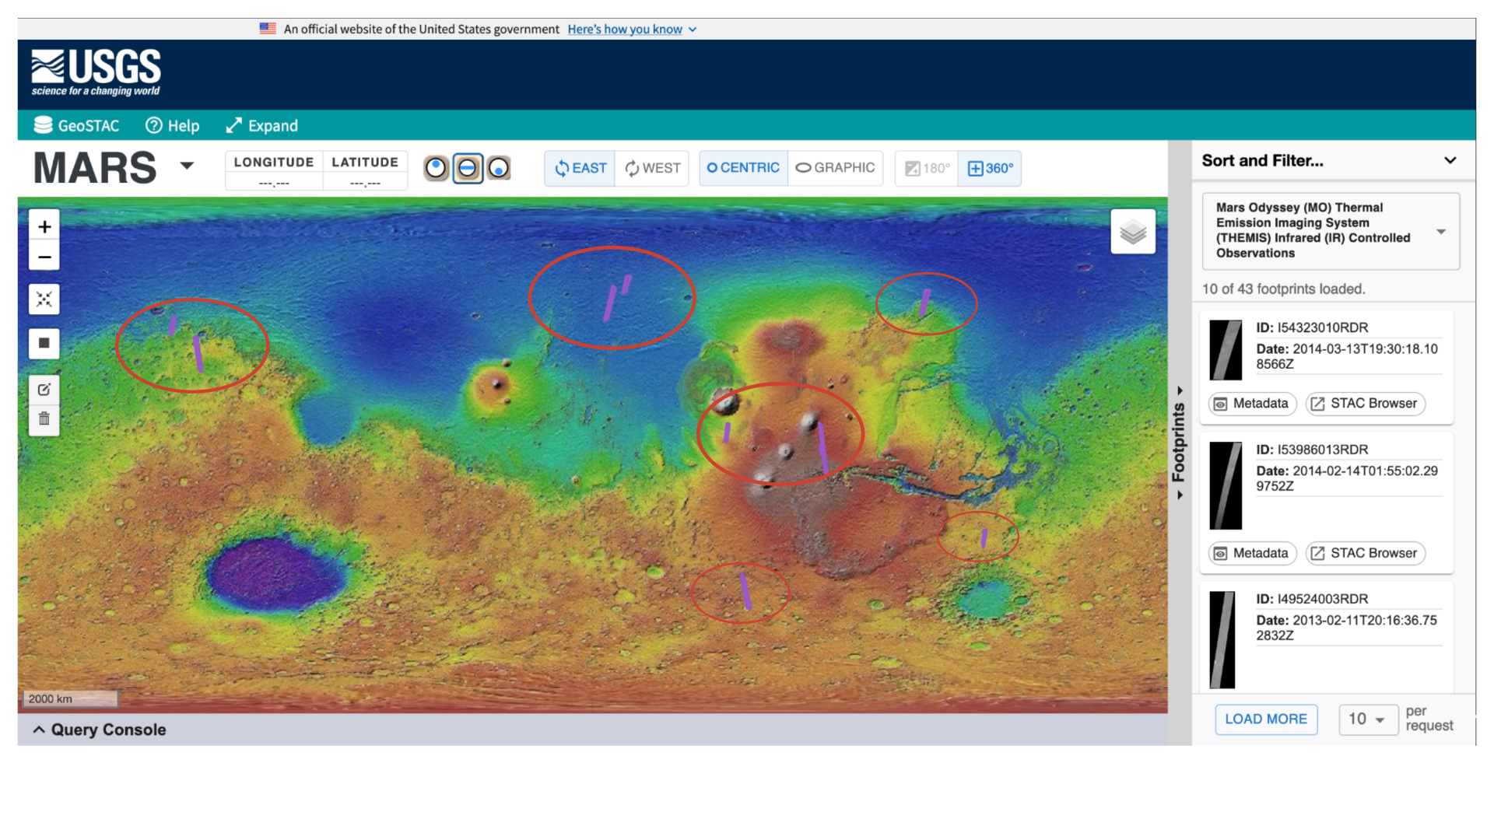
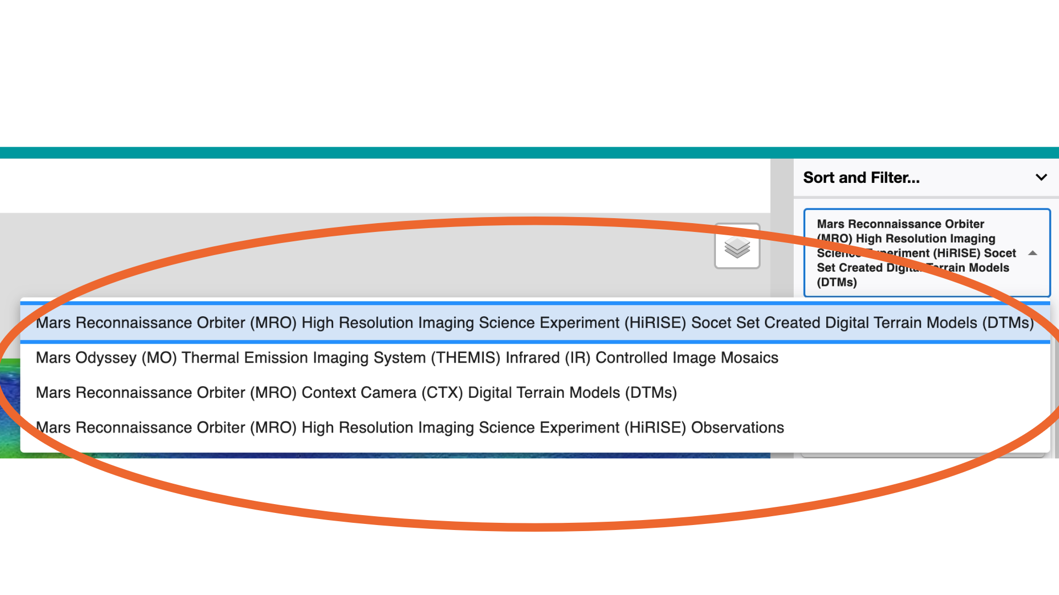
Problem
The current application uses only raster data.
Vector data is available but is not currently being used.
Stylization of footprints is currently very limited.
https://stac.astrogeology.usgs.gov/geostac/

Slide 5
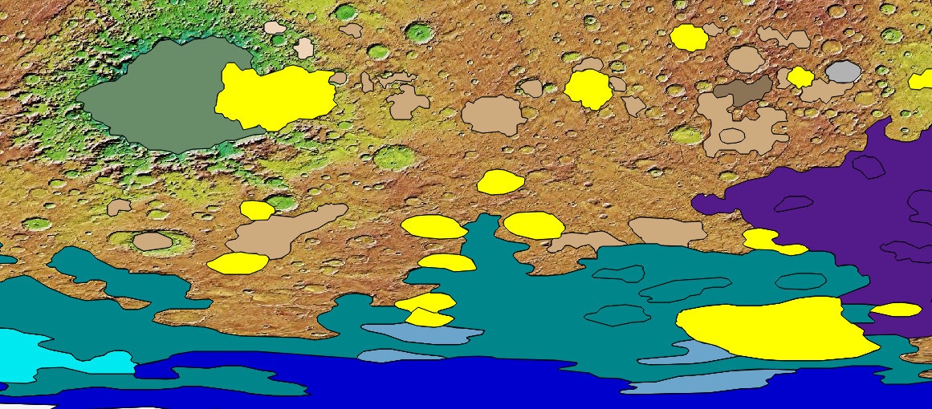
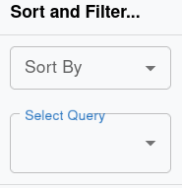
Solution
Integrating the the Vector API into GeoSTAC using PyGeo API software, and modifying the existing tools to work with the Vector API.
Using Leaflet to display vectors and Leaflet.SLD to style them
Creating compatibility with ElasticSearch and displaying to the website using React
Map stylized with feature specific colors
Query selection box

Slide 6
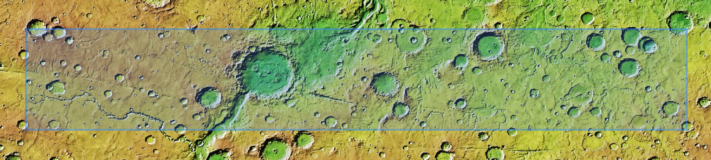
Implementation Overview
(Requirements)
Rendering
Stylizing
Searching
Access GeoJSON data through new Vector API.
Using SLD and SVG files to make the data useful.
Making the data accessible for the users.
*Mars GeoSTAC Web Application

Slide 7
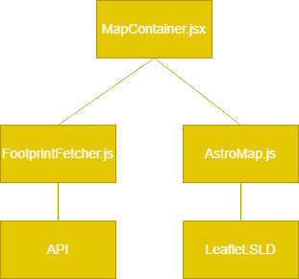
Implementation

Slide 8
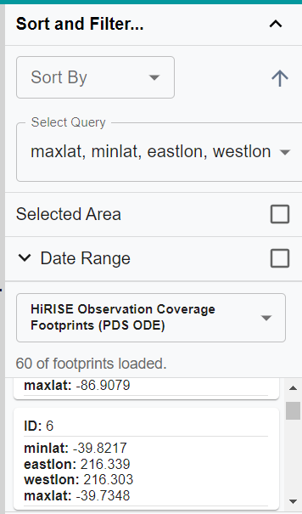
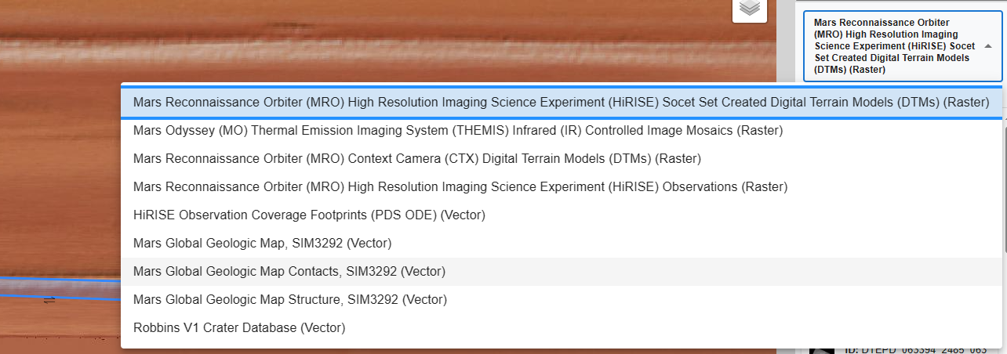
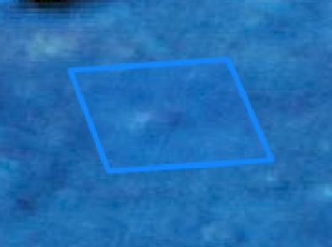
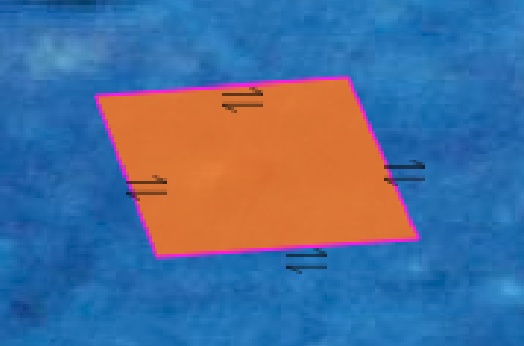
Implementation of API and Styling
- Custom GeoJSON styling with symbology
- Default GeoJSON style

Slide 9
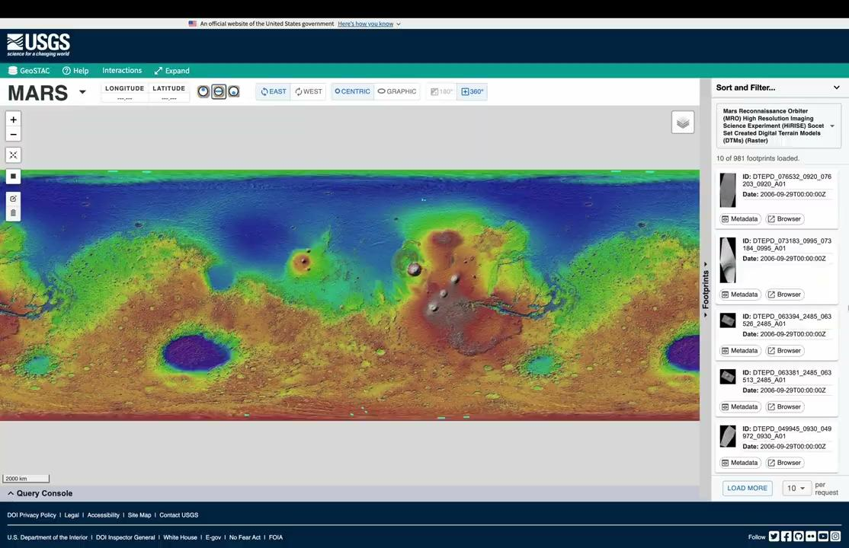
Prototype Review

Slide 10


Challenges and Resolution

Slide 11


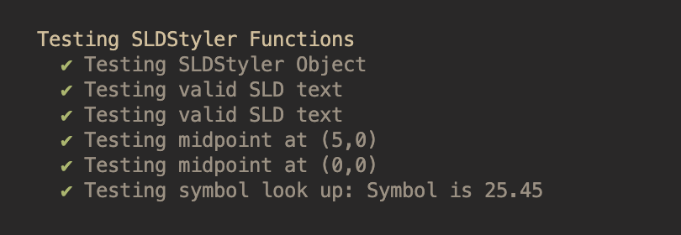
Testing Plan
Using Mocha testing suite and Chai Assertion Library
Tests will be used as a benchmark to confirm functionality
Issues from tests will be fixed right away
Successful test results from Mocha and Chai Assertion Library

Slide 12
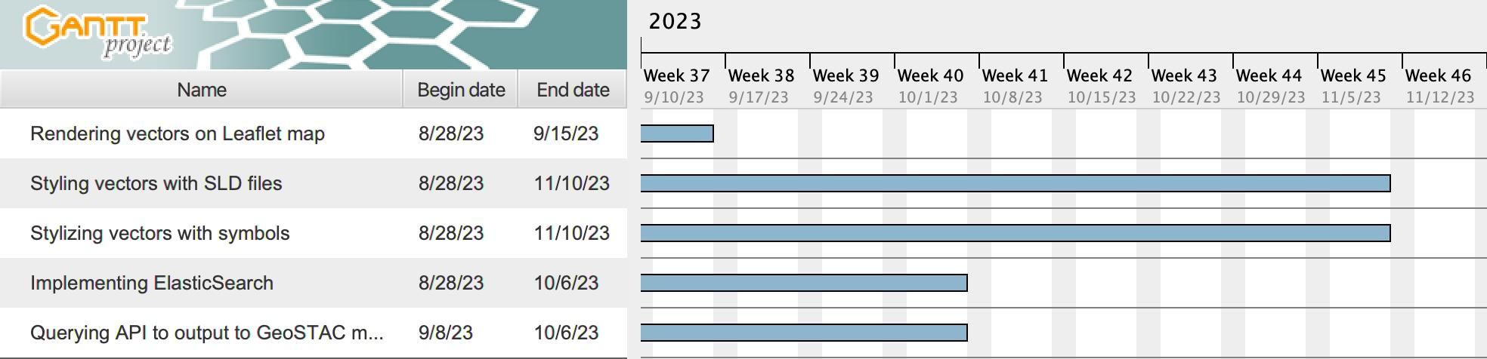
Schedule

Slide 13

Conclusion
Functional Requirements:
  Rendering, Stylizing, Searching.
Implementation:
  Rendering
    GeoJSON files using Vector API
  Stylizing
    Modified Leaflet.SLD functionality
  Searching
    Filterable attributes
Challenges/Resolution:
  Licensing

